Slide 1
Data Privacy
Boston University CS 506 - Lance Galletti

Slide 2
Disclaimer
A large part of this talk is my opinion. I encourage you to disagree, discuss, and debate throughout.

Slide 3
Why I care
To me, privacy is not about hiding illegal activity.
It’s about:
Freedom of choice
Equal opportunity / non-discrimination
Accountability and transparency

Slide 4
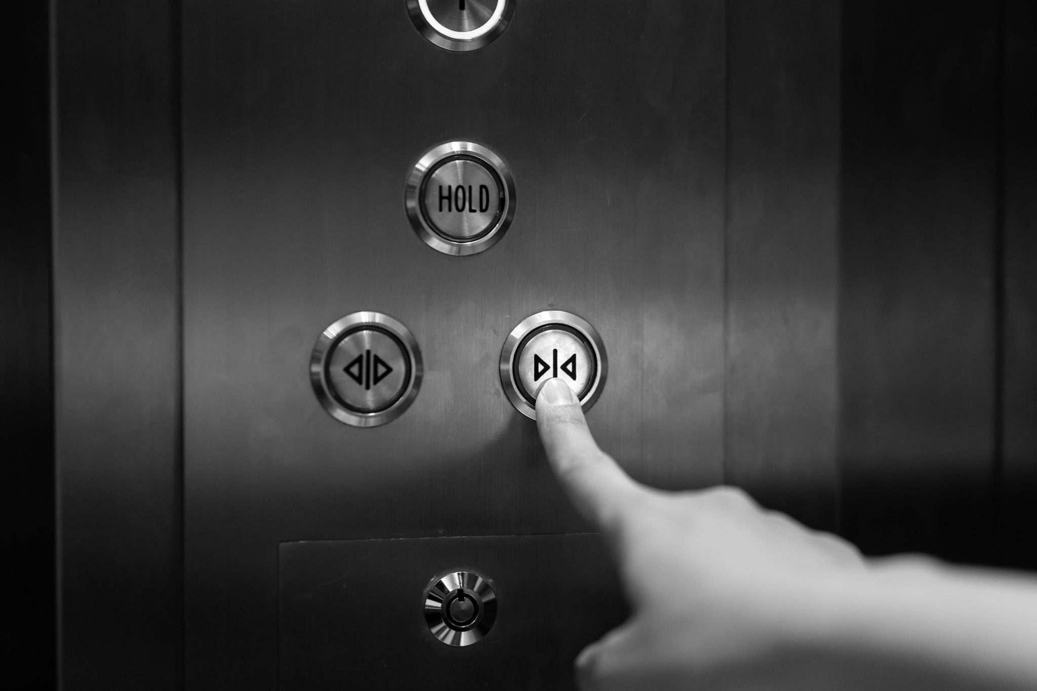
User - Product Relationship Today
Notes:
Most online platforms are proprietary software. This means the only part of the digital world that is and will ever be visible is the collection of User Interfaces (UIs) defined by platforms.
A UI is just a small, sometimes misleading [0], window into the inner workings of a platform. Users must trust that platforms are accurately representing their inner workings if they are to make reasonable online decisions.

Slide 5
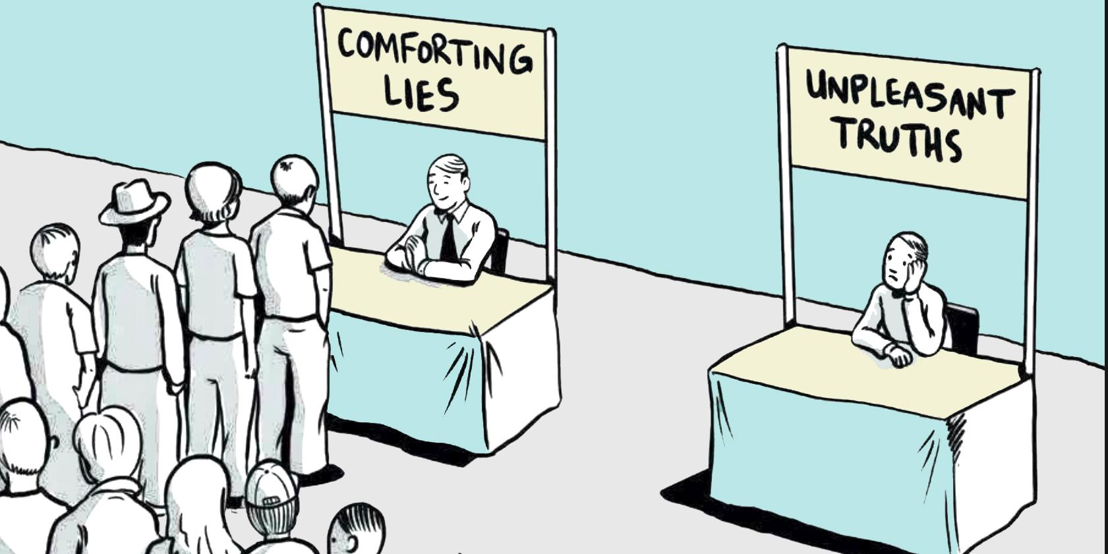
User - Data-Driven Product Relationship Today
Notes:
Data-driven platforms collect and analyze data submitted by users so they may customize the UI to each individual user.
While the experience of personalized recommendations may seem positive, only being exposed to what you like or already believe in can ultimately have negative societal impacts.
Examples include biasing search for information [1] and furthering polarization of societies[2].

Slide 6
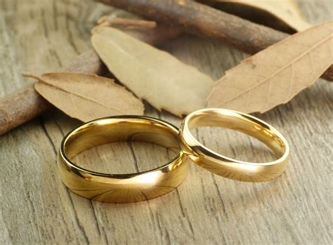
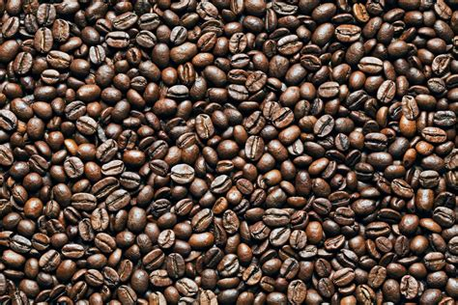
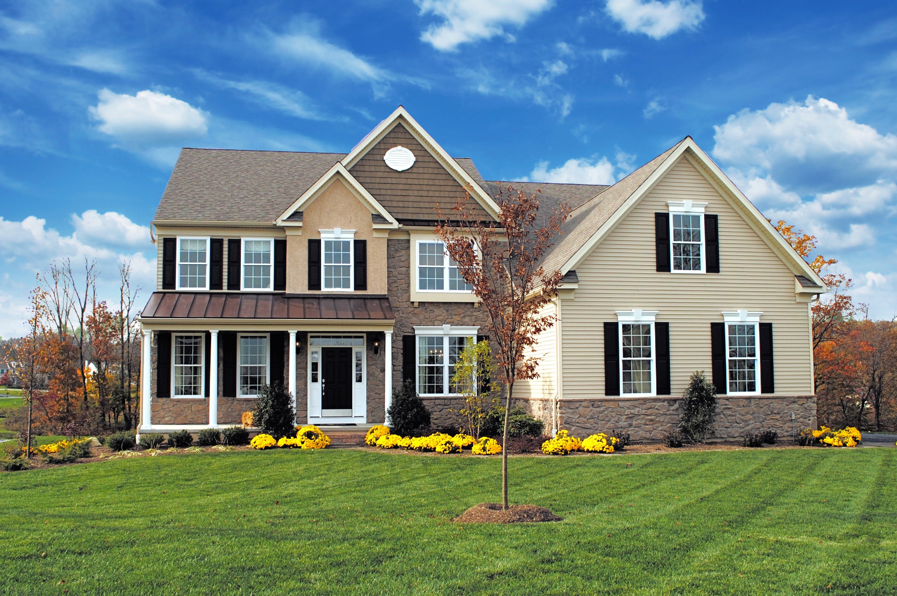
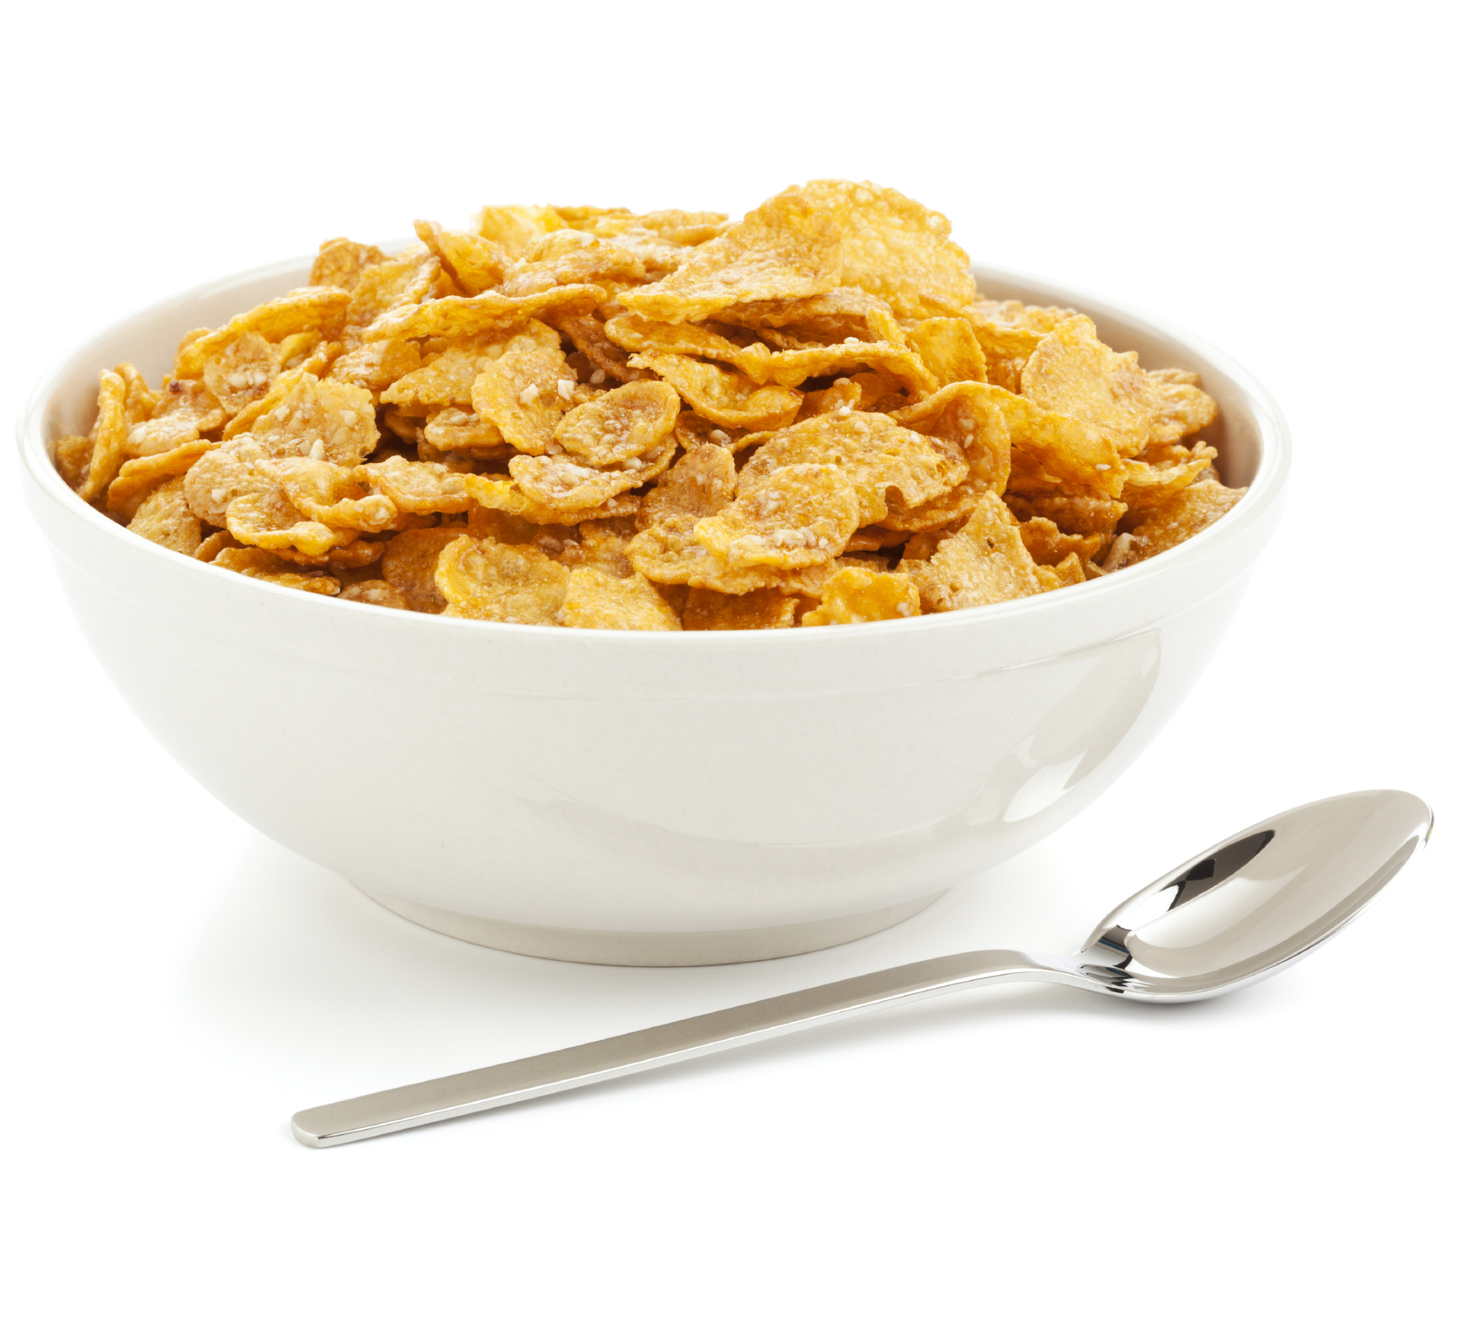
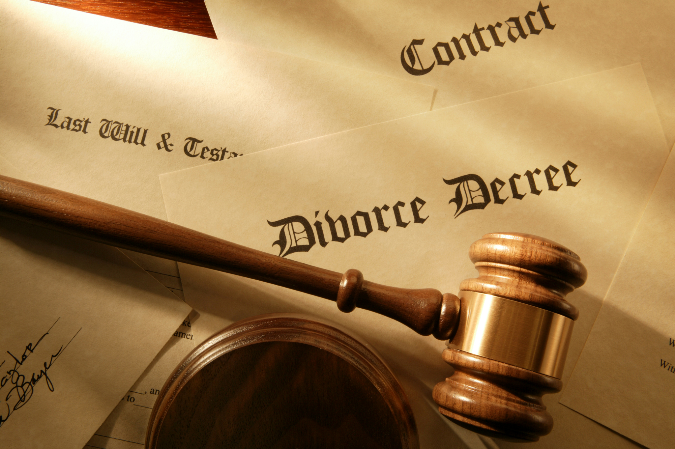
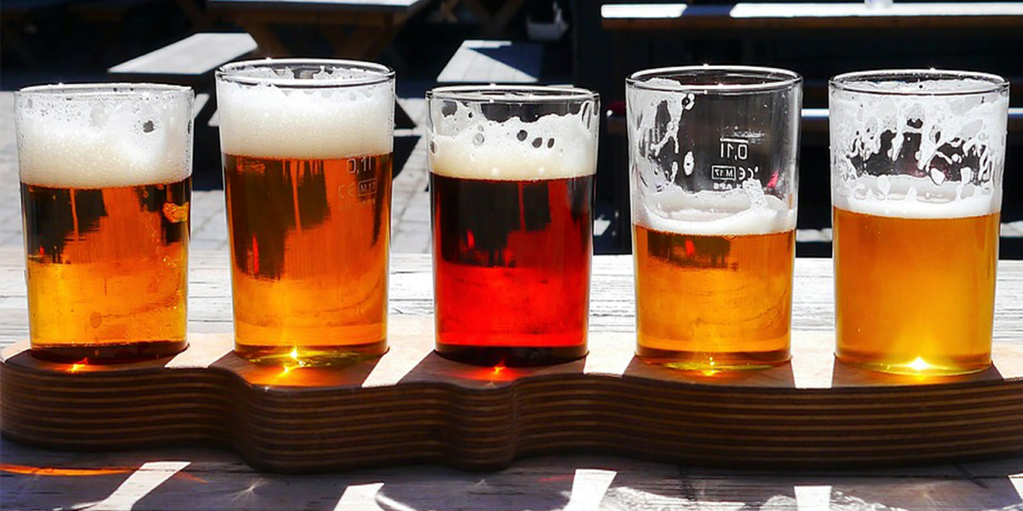
User - Data-Driven Product Relationship Today

Slide 7

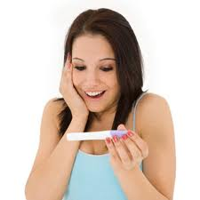
User - Data-Driven Product Relationship Today
Notes:
Data ultimately shapes the digital world users interact with, customizing platform behavior to user preferences. Neither the data nor the analysis methods driving these recommendations are made available to users. This means users are unable to verify or understand the accuracy and extent of information extracted (and extractable) from the data they submit.
Patterns can be learned and exploited to affect users in targeted ways [3], customizing user behavior to platform preferences. These patterns too are not disclosed to users, inhibiting their ability to change the likely outcomes that await them — arguably stealing agency from users.

Slide 8
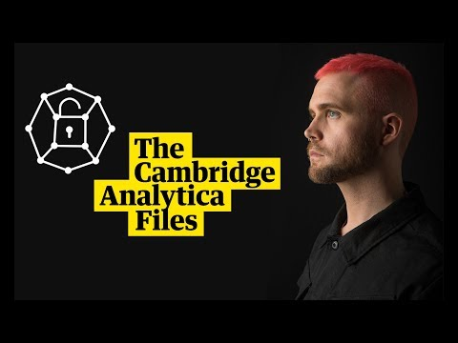
Freedom of Choice
Notes:
Armed with user data, these platforms have shown they can have global impact: shaping public opinion and mass behavior, spreading misinformation, impacting voter preferences and political stability [5].
https://www.youtube.com/watch?v=Q91nvbJSmS4
An impact that would have likely remained unknown were it not for whistleblowers — insiders with a slightly larger window into the platform [6].

Slide 9
Freedom of Choice
Q: Do you think you are in control of your decisions or do you think your actions / decisions are determined by forces external to your will?
Q: What affects your decision process?
Q: When making decisions, is it better to be aware of the factors that influence these decisions?
https://en.wikipedia.org/wiki/Groundhog_Day_(film)

Slide 10
Data Determines
Access to:
Health care
Insurance
Loans
Information
Jobs
Distribution of funds
Release from prison
And more!

Slide 11
Bias
Lack of transparency and thus accountability.
These patterns are learned on historical data: reflecting society’s past and existing biases and inequalities [4] which are then perpetuated by that same lack of visibility and accountability.
Garbage in - Garbage out: training state of the art models on garbage data can only produce garbage results
Notes:
if we look at the popular rise of facial recognition tools over the past few years, people of color have been excluded from the design and implementation process. The tools are often discriminatory, fail to recognize people of color, and at times, misgender them. However, in parallel, facial recognition technology is increasingly integrated into police and state surveillance tools, and perfecting that technology could significantly further impact communities that are already over-policed and over-surveilled. This has led us to call out, “Please Don’t Include Us.
We just watched Joy’s video. What does this tell us about HireVue’s system?
Do you think it reads certain faces more accurately? Which ones? Why?
Could their system be racist? Why? How would we know if they were biased?

Slide 12
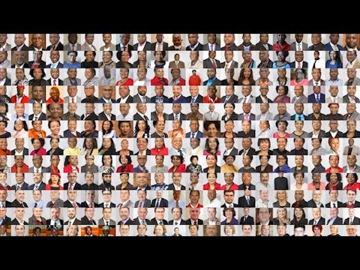
Bias
Notes:
if we look at the popular rise of facial recognition tools over the past few years, people of color have been excluded from the design and implementation process. The tools are often discriminatory, fail to recognize people of color, and at times, misgender them. However, in parallel, facial recognition technology is increasingly integrated into police and state surveillance tools, and perfecting that technology could significantly further impact communities that are already over-policed and over-surveilled. This has led us to call out, “Please Don’t Include Us.
We just watched Joy’s video. What does this tell us about HireVue’s system?
Do you think it reads certain faces more accurately? Which ones? Why?
Could their system be racist? Why? How would we know if they were biased?

Slide 13
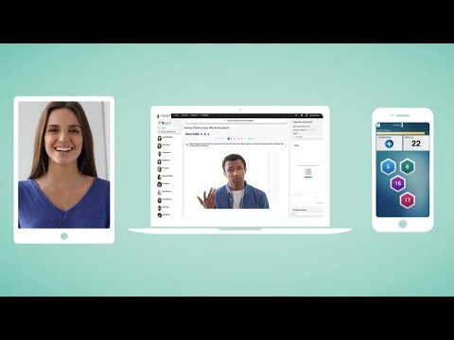
Bias
Facial recognition being used more and more: https://www.washingtonpost.com/technology/2019/10/22/ai-hiring-face-scanning-algorithm-increasingly-decides-whether-you-deserve-job/
Notes:
if we look at the popular rise of facial recognition tools over the past few years, people of color have been excluded from the design and implementation process. The tools are often discriminatory, fail to recognize people of color, and at times, misgender them. However, in parallel, facial recognition technology is increasingly integrated into police and state surveillance tools, and perfecting that technology could significantly further impact communities that are already over-policed and over-surveilled. This has led us to call out, “Please Don’t Include Us.
We just watched Joy’s video. What does this tell us about HireVue’s system?
Do you think it reads certain faces more accurately? Which ones? Why?
Could their system be racist? Why? How would we know if they were biased?

Slide 14
Bias
Predicting criminality from faces: https://arxiv.org/pdf/1611.04135.pdf
Sexist AI: https://www.telegraph.co.uk/technology/2018/10/10/amazon-scraps-sexist-ai-recruiting-tool-showed-bias-against/
Sometimes adding more tech to a problem can make new problems...

Slide 15
Correlation vs Causation
Data used for risk assessment in releasing prisoners
https://www.technologyreview.com/s/613508/ai-fairer-than-judge-criminal-risk-assessment-algorithm/
Again black box algorithms

Slide 16
Critical Algorithms Studies
https://socialmediacollective.org/reading-lists/critical-algorithm-studies/
Notes:
Improvements in medicine

Slide 17
Subject to Future Scrutiny
With data being stored potentially indefinitely, data shared today will be subject to the latest cutting-edge information-extraction techniques of years and decades from now. This far exceeds the timescale we are used to engaging with and we cannot predict what information future tools will be able to extract from the data we submit today.
Users cannot then reasonably consent to all the ways in which their data, whose richness is undisclosed and will only increase with the pace of technology, is used or will be used.

Slide 18
Challenge of Regulations
What control users do have over their data is entirely at the whim of the UI exposing and accurately acting upon that control.
Regulations [7] have mandated UI changes that have made it possible, for example, for some users to delete their data from platforms. Such regulations are difficult to enforce because it ultimately boils down to our ability to verify software correctness.
What’s worse, users can follow the UI steps to delete their data but the information extracted from this data may have already been incorporated into the models at large — a change that cannot be undone.

Slide 19
PII - Personally Identifiable Information
Most Data Privacy laws are based on hiding / removing PII. But PII is contextual.
Uniquely identified by zip, birthday, and sex:
https://arstechnica.com/tech-policy/2009/09/your-secrets-live-online-in-databases-of-ruin/
De-Anonymization of Netflix dataset using Amazon Reviews
https://courses.csail.mit.edu/6.857/2018/project/Archie-Gershon-Katchoff-Zeng-Netflix.pdf

Slide 20
Data Brokers
One argument for privacy has been that Data Brokers and companies make money off of your data and individuals deserve to get a slice of the pie.
https://clearcode.cc/blog/what-is-data-broker/
Q: if you can sell your data, how much is your identity worth?

Slide 21
What can you do now?
Ask if giving your data is required
Read the terms and conditions to understand what is done with your data
Clear cookies
Reflect on what activity patterns define you (PII)
Think about what data you leak across software - try to compartmentalize, make it difficult to join your data from different sources
Reflect on the decisions you make

Slide 22
Research I have been doing
Find incentives for companies to move to privacy conscious tools
Create tools for users to regain control over their data and agency over their lives

Slide 23
Incentivizing the use of privacy preserving tools
How do we define privacy? - differential privacy makes an attempt
What are the drawbacks? What must a company give up to make the transition? What types of applications would be unaffected today?

Slide 24
Differential Privacy - How it works
Key idea: learn about the population not about any specific individual.
Many ways to do this. One way is to store data in the following way:
Ask user A if they have attribute B (example: do you smoke etc.)
Toss a coin.
If Heads then answer honestly.
If Tails, then flip again.
If Heads then answer “Yes”
If Tails again then answer “No”.

Slide 25
Differential Privacy - How it works
Assume true proportion of Attribute B is p. How do we estimate p?
What proportion of Attribute B (call it p_{obs}) do we expect?
T
H
½p
So p_{obs} = ½p + ¼
Meaning
P = 2 * (p_{obs} - ¼)
N
Y
¼

Slide 26
Differential Privacy - Limitations
Generally complex: needs more simple examples to explain how it works (this is where you can contribute today!)
No consensus on how to calibrate the odds of the coin flip in the previous example (every company uses a different value and doesn’t usually disclose it - ex: apple)
Does not work if you’re looking to analyze outliers or do anomaly detection
Does not work well on small datasets

Slide 27
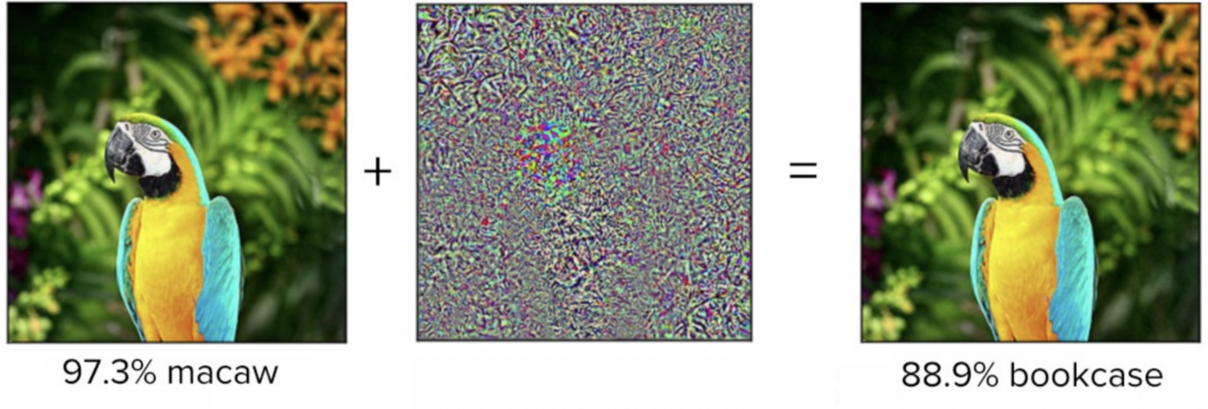
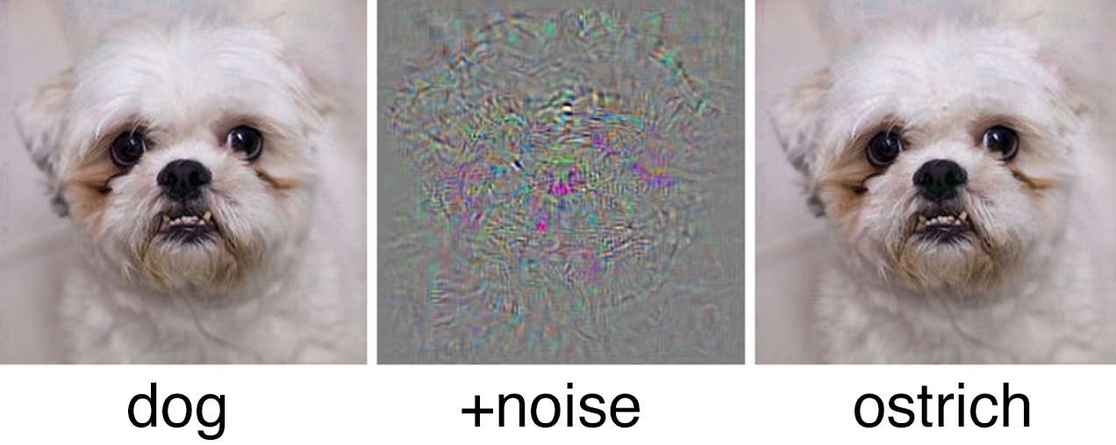
Privacy Tools for the Average User
Fooling Classifiers by creating adversarial examples.

Slide 28
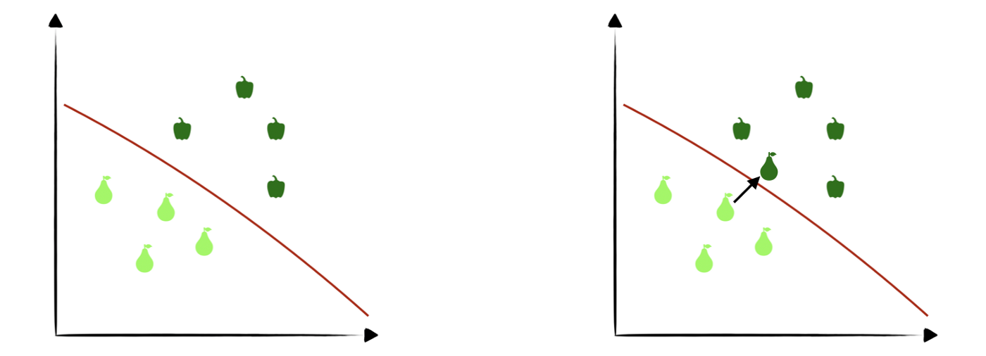
Privacy Tools for the Average User
In order to fool a given model, we need a process by which we can move data slightly passed the decision boundary

Slide 29
More Links
https://www.heinz.cmu.edu/~acquisti/papers/AcquistiGrossStutzman-JPC-2014.pdf
https://www.heinz.cmu.edu/~acquisti/papers/Acquisti_Welfare_Impact_of_Targeted_Advertising_WP.pdf

Slide 30
Some Advice For Job Searching
What are your principles? What will you be uncompromising about? What gets you fired up? What do you believe in?
Don’t change yourself to meet what you think the company wants to see
When you interview you are also interviewing them
Interviews are often more about “fit” than they are about technical competency (hence the importance of 1 - 3)
For your first job it’s good to have great mentors to help you learn
How senior is the team you’ll be working with?
You’re not an imposter - no one knows everything. Be transparent about what you do and don’t know. Be willing to learn.

